Slide 1

WHICH BRAND PRODUCES THE BEST-PERFORMING SPORTS CARS? BY JOSHUA VILLAROJO

Slide 2
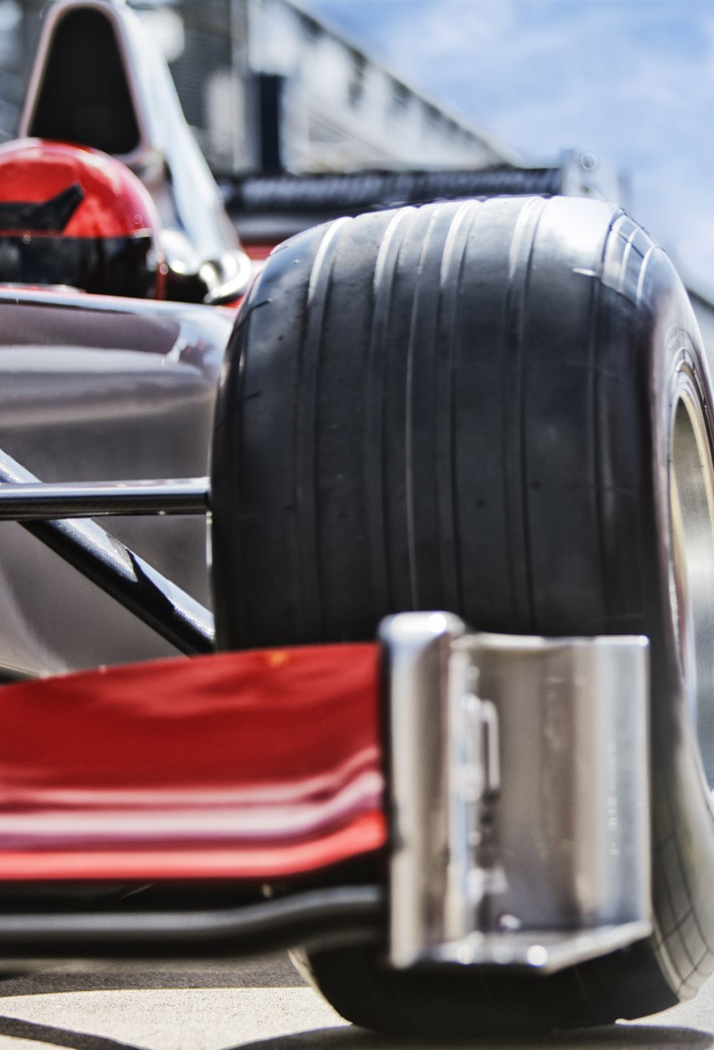
PROJECT GOAL
To determine which car brand consistently produces the highest-performing sports cars using regression analysis on real-world-style data.

Slide 3
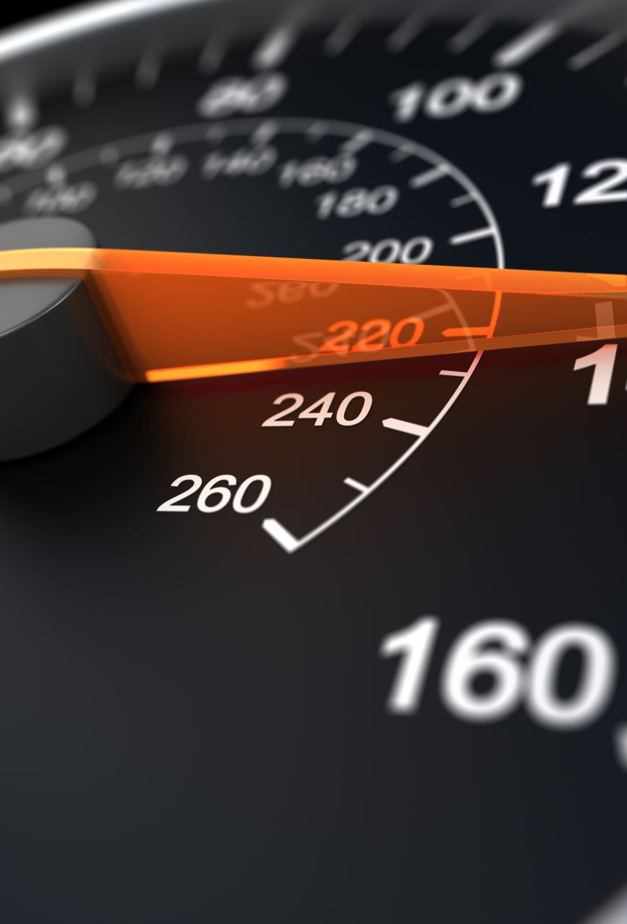
DATASET OVERVIEW
5,000 sports cars
Features: Horsepower, Engine Size, Acceleration, Top Speed, Fuel Efficiency, CO2 Emissions, Insurance Cost, etc.
Includes brand, condition, fuel type, and more.

Slide 4


DEFINING PERFORMANCE
PERFORMANCE IS PRIMARILY REPRESENTED BY TOP SPEED, ACCELERATION (0-100 KM/H), AND HORSEPOWER.
WE ALSO CONSIDER WEIGHT, FUEL EFFICIENCY, AND CO2 EMISSIONS AS INFLUENCING FACTORS.

Slide 5
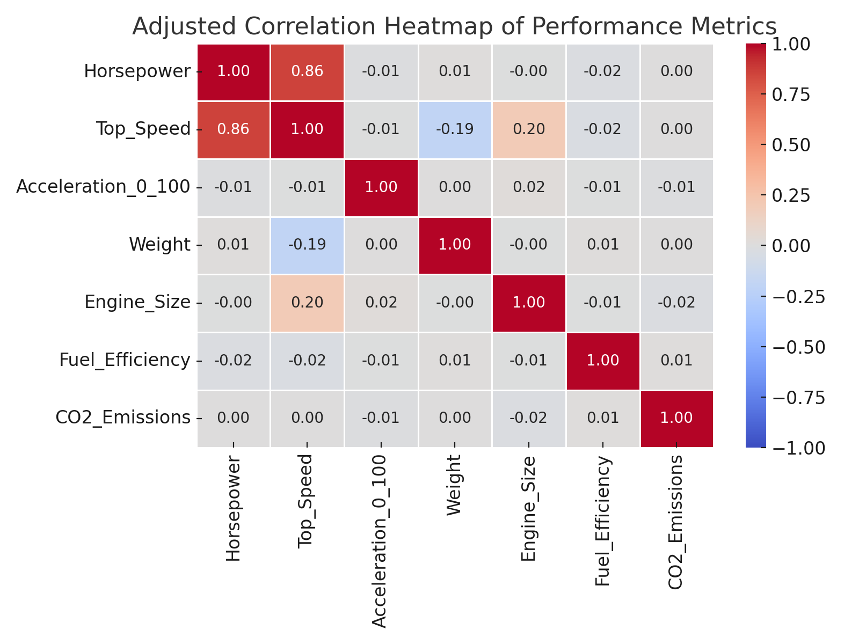
CORRELATION HEATMAP

Slide 6
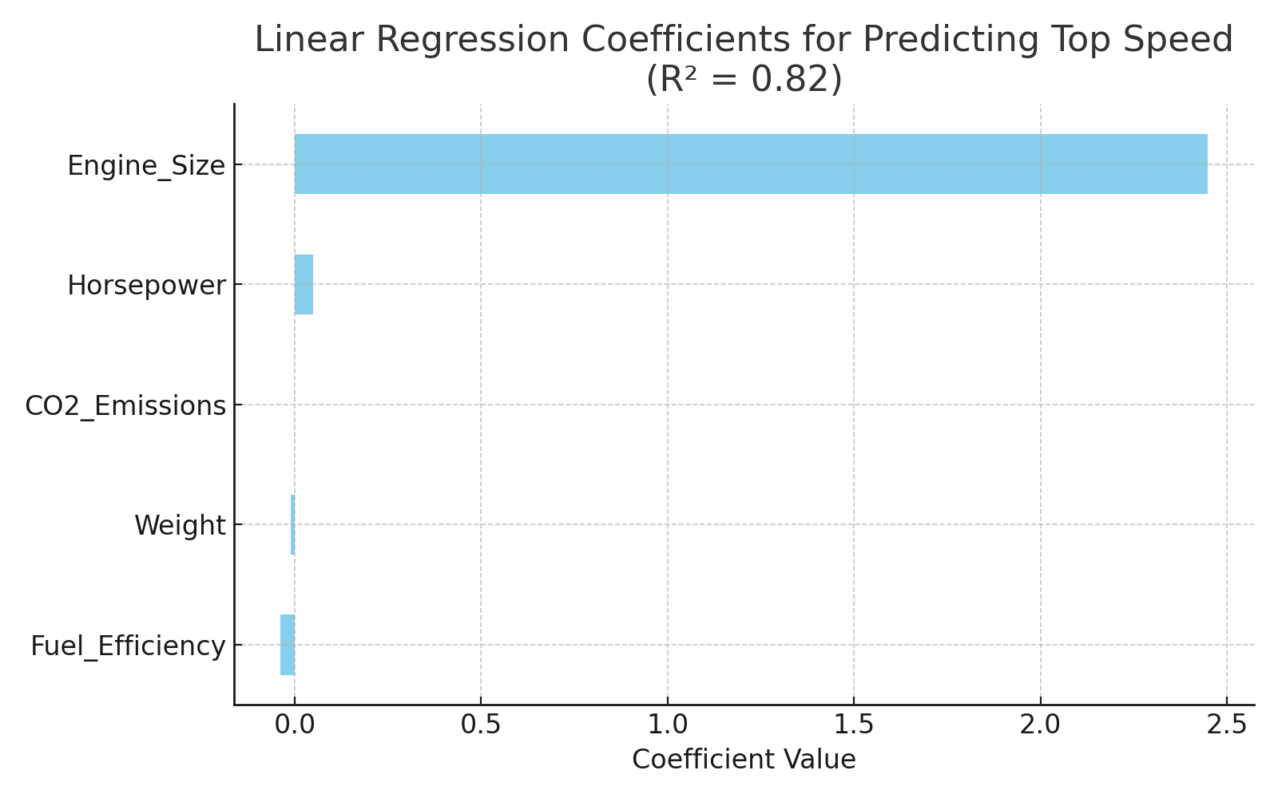
REGRESSION COEFFICIENTS (TOP SPEED)

Slide 7
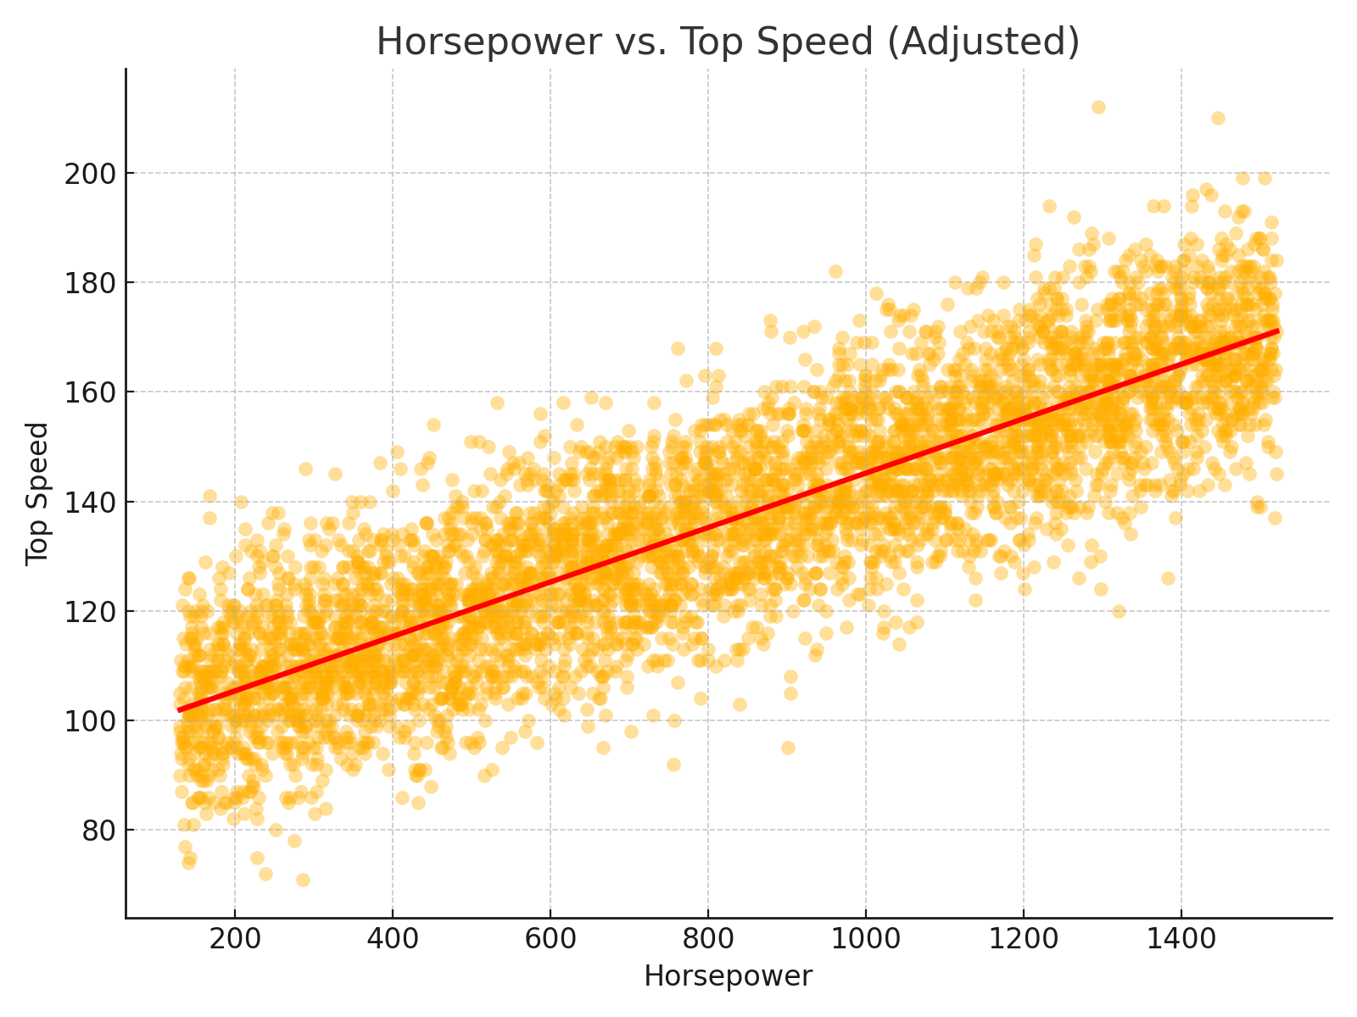
HORSEPOWER VS. TOP SPEED

Slide 8
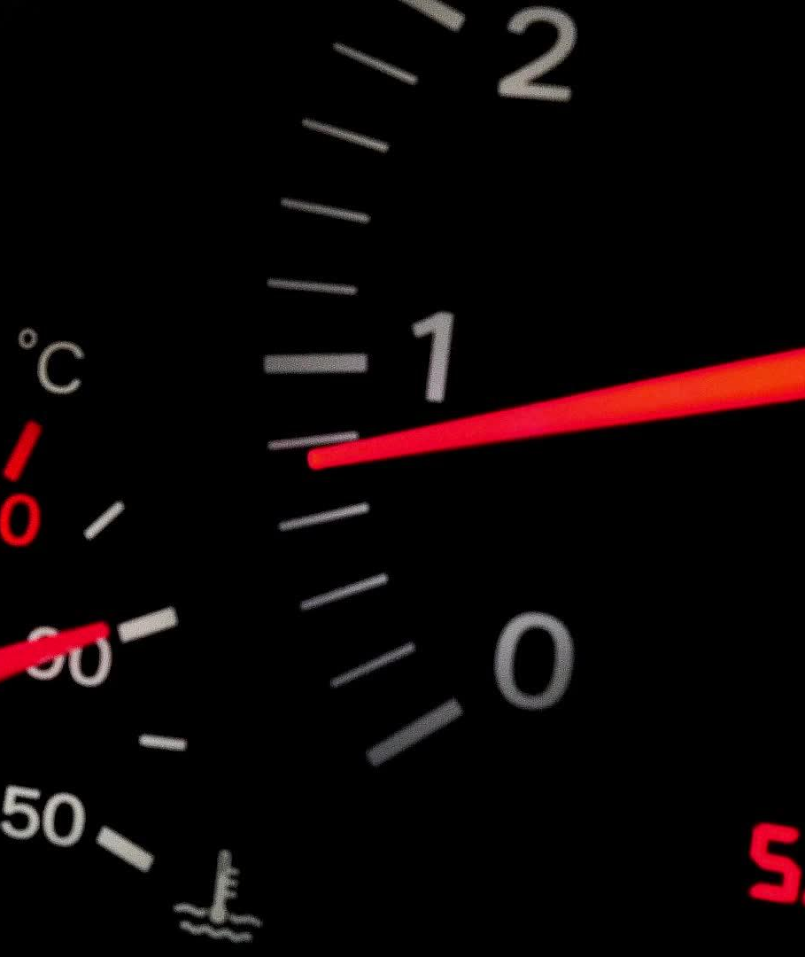
KEY FINDINGS
Horsepower and Engine Size are the strongest positive predictors of Top Speed.
Weight and Fuel Efficiency are negatively associated with Top Speed.
CO₂ Emissions also show a slight negative correlation with Top Speed.

Slide 9
CONCLUSION
Regression results and EDA suggest certain brands—based on high horsepower and top speed—consistently build high-performing cars.
Further brand-wise analysis and visualization can identify the top brand.

Slide 10
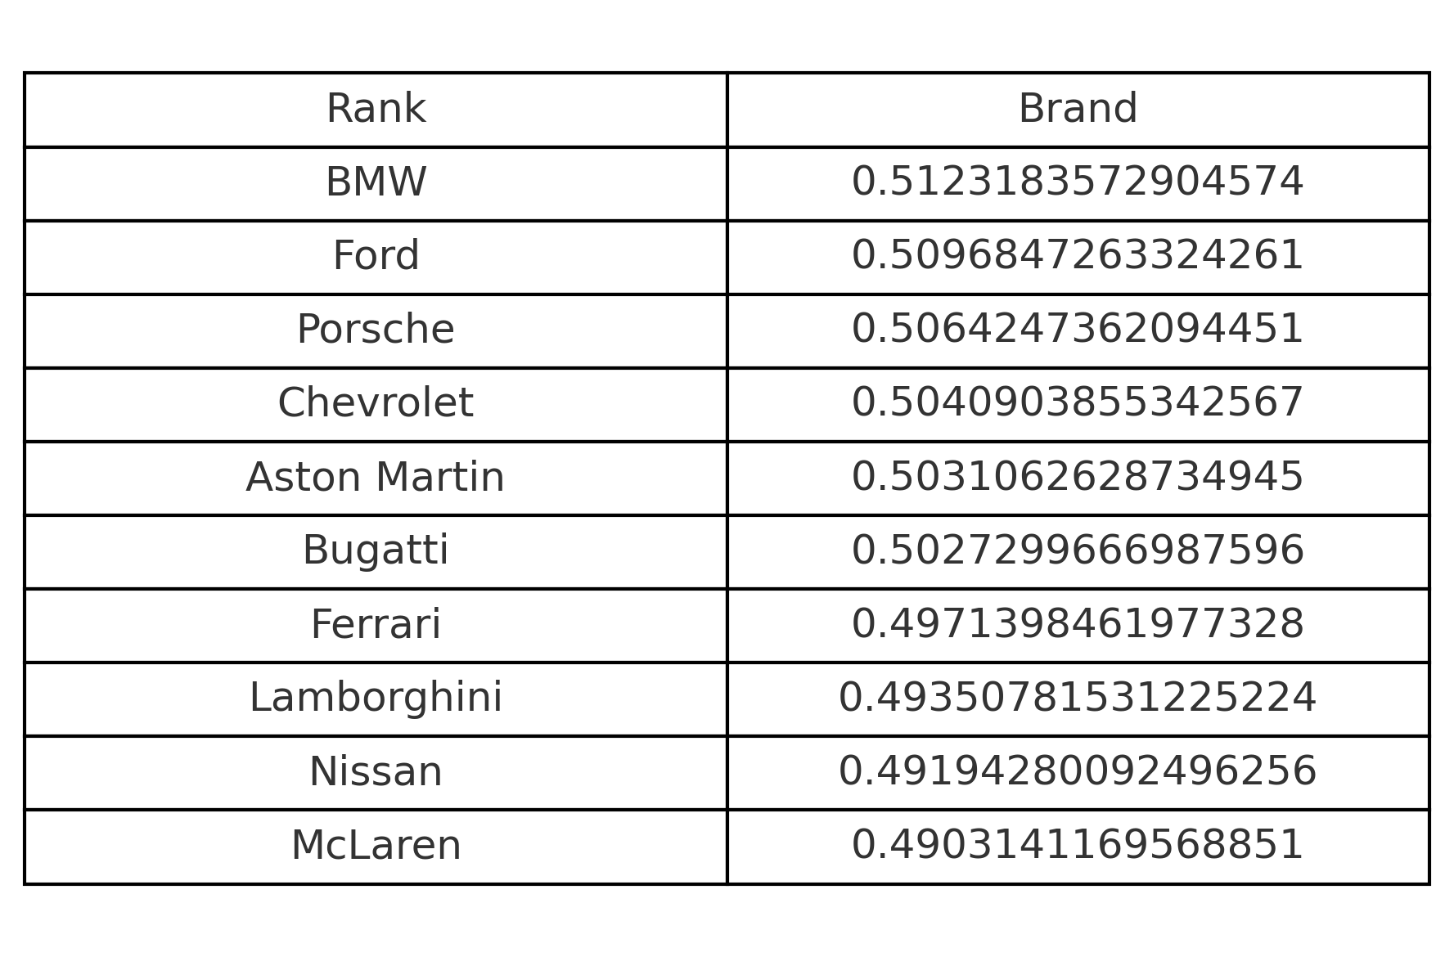
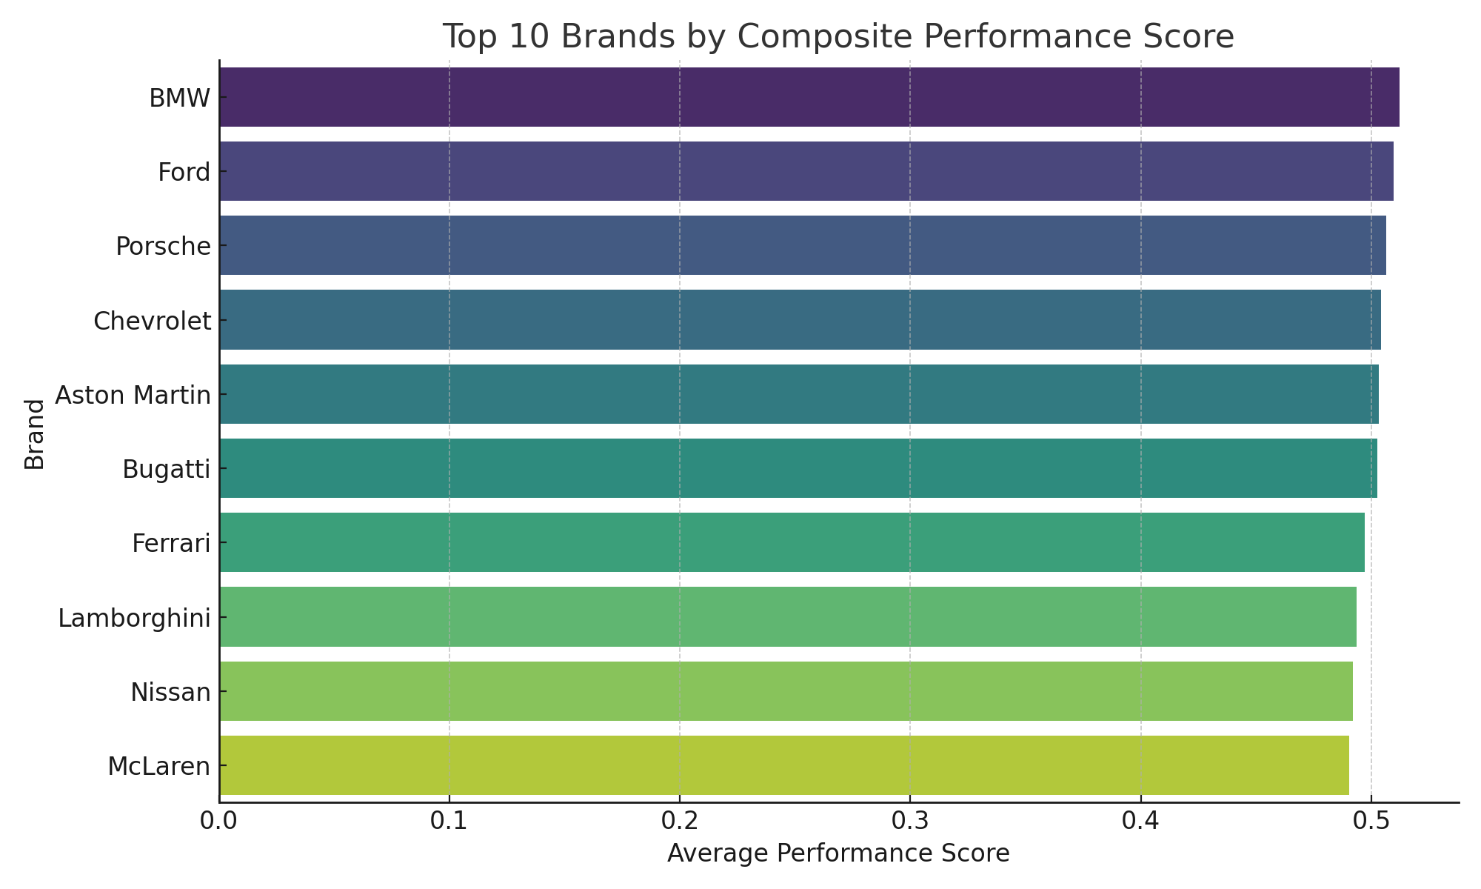
TOP 10 BRANDS BY COMPOSITE PERFORMANCE SCORE

Slide 11

SUMMARY OF FINDINGS
A composite score was built using horsepower, top speed, acceleration, fuel efficiency, and weight.
Regression results and EDA showed horsepower and engine size are key predictors of performance.
Brand-level analysis revealed the top 10 brands based on the calculated performance score.

Slide 12
THANK YOU FOR YOUR TIME!

